Slide 1
SpaceApp Challenge 2019
Canadian Space Agency
STRATOS Challenge
    Short Presentation
    October, 2019

Slide 2
Introduction
My name is J-F Cusson, I have been working for the Canadian Space Agency for 20 years. I am a software/digital electronics Engineer. For a couple of years, I have been part of the CSA Stratos team.
I am very pleased to propose this challenge, based on data gathered from stratospheric balloons during Stratos campaigns, using the PRISM sub-system.

Slide 3
The Challenge
We need you to propose a way to display a set of data and images on a single screen web-based dashboard, so that operators, scientists and the general public can follow our flights. The display will need to be…
USEFUL
BEAUTIFUL/ENJOYABLE
INFORMATIVE
We seek your technical expertise but also your imagination, artistic touch and web layout skills!

Slide 4
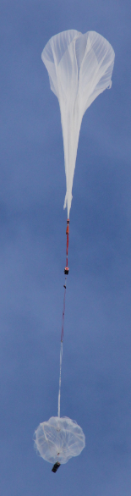
CSA PRISM Sub-System
Stratospheric balloons are used to carry payloads in the upper atmosphere for scientific investigation and demonstration purposes.
The vast majority of payloads require data management (e.g. telemetry, telecommands, clock synchronization, time-stamping, localization, attitude and environment data, logging, mass storage…) to accomplish their mission.
The CSA Stratos PRISM Subsystem provides these services, offered to users flying aboard a gondola, whom have not integrated a complete attitude & heading reference, and command and data handling system to their payload.

Slide 5
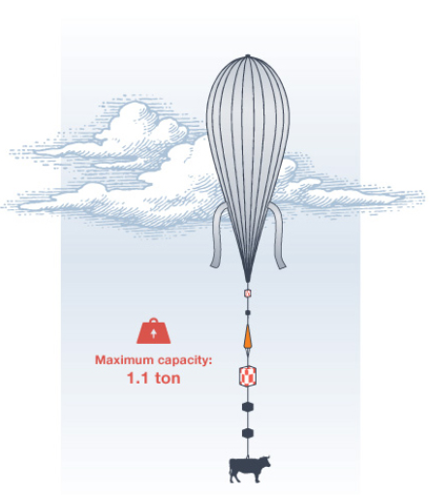
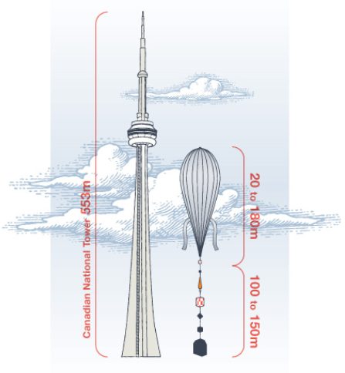
Perspective
Envelope & Flight Train
PRISM & Scientific payloads go there

Slide 6
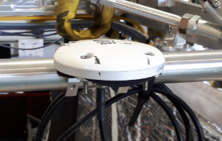
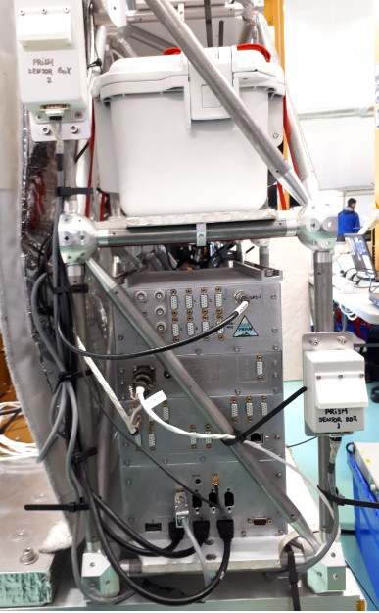
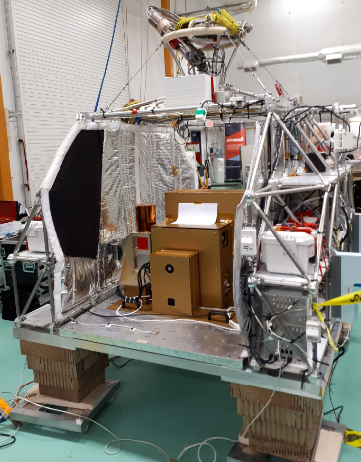
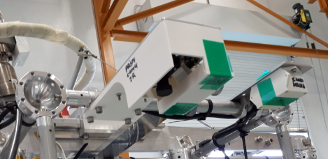
PRISM Integration
GPS
Antenna
Sensors
PRISM
Main
enclosure
Cameras
The Science Gondola

Slide 7
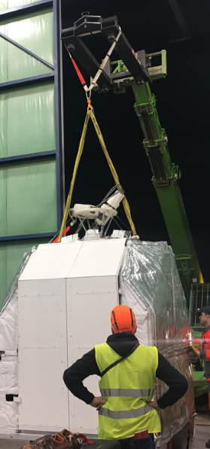
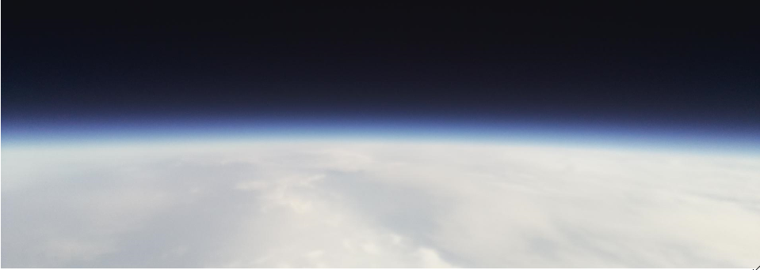
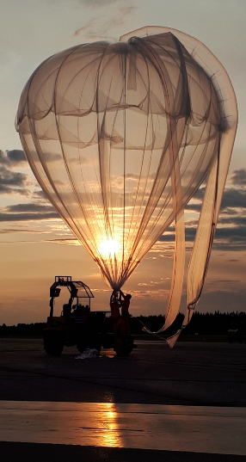
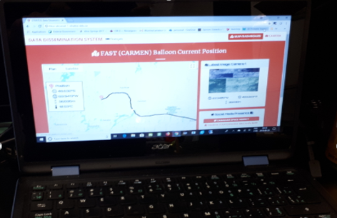
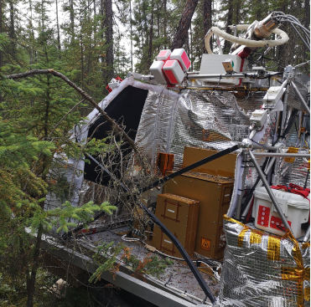
2018 Flight
(CSA base, Timmins, Ontario)
Launch at night (Aug. 26th)
Flight duration: More than 11h
Altitude reached: Above 36km

Slide 8
Data Generated by PRISM
Position
Attitude/Heading
Environment
Housekeeping Data
Event Logs
Pictures

Slide 9
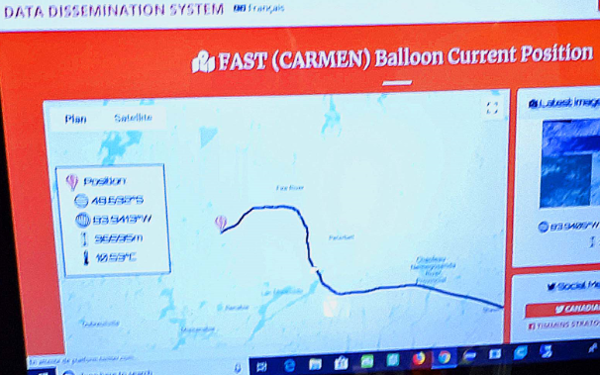
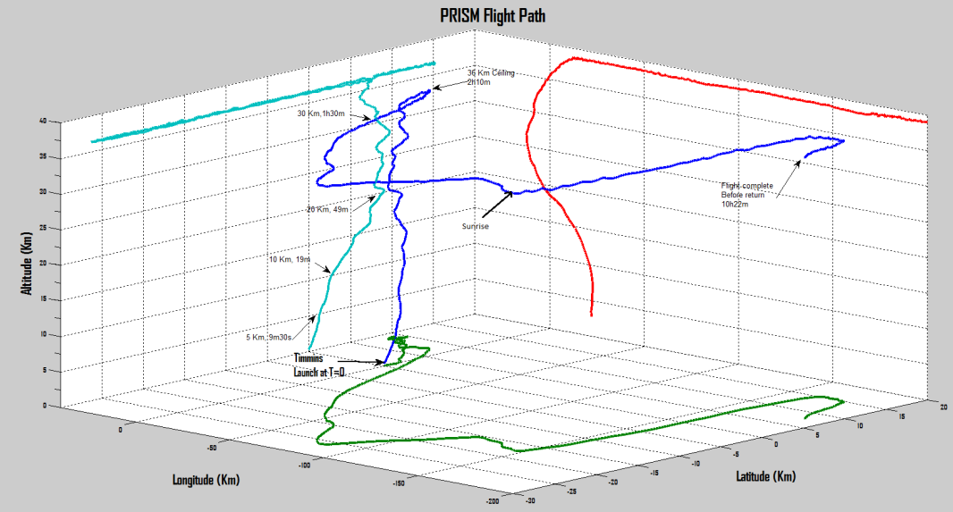
Position

Slide 10
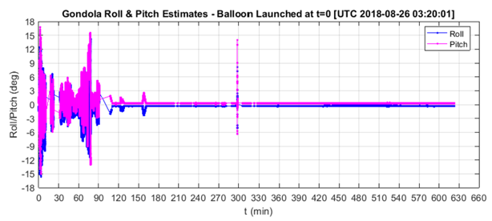
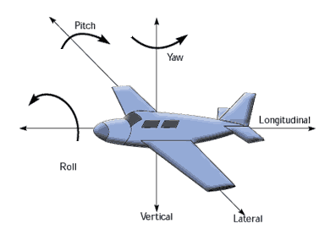
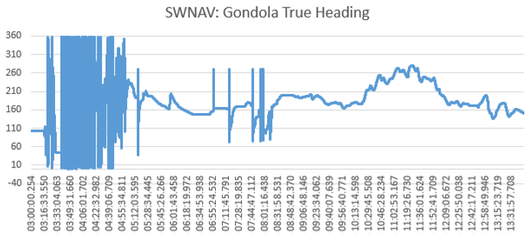
Attitude/Heading
Note: Yaw = Heading (in our case)

Slide 11
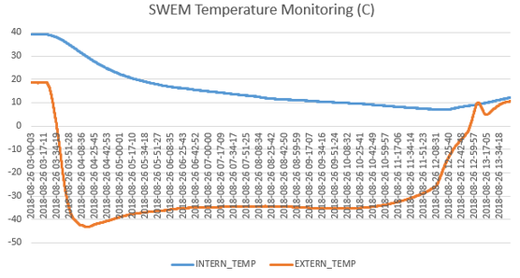
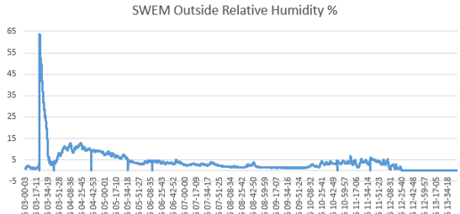
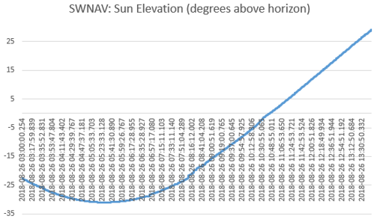
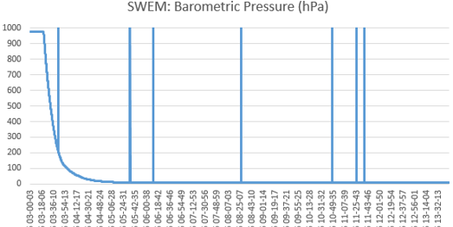
Environment

Slide 12
Housekeeping Data + Event Logs
Housekeeping data: Provide information used to assess the current state and health of the system.
Event log: Significant events about the operations of the system are recorded (e.g. taking pictures). Provides additional information + time of each event.

Slide 13
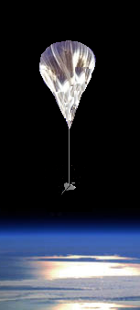
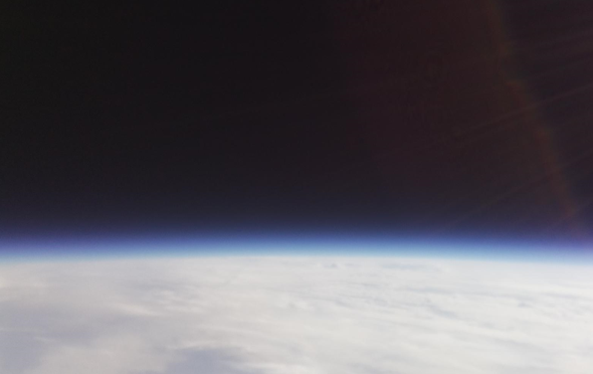
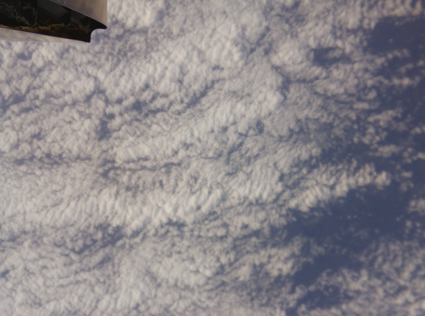
Pictures
Images were automatically taken every 2 minutes, alternating between HORIZON and NADIR
Horizon pointing
Nadir (down toward Earth) pointing

Slide 14
Data Format & Time Stamps
All data was recorded in text files, one entry per line
Each entry is identified, provided document details content
Each entry is TIME STAMPED
Each element is separated from others by commas
TIME STAMP:
Example: 2018-08-26 03:01:29.842 (August 26th 2018, 3am. + 1 minute, 29 seconds & 842 milli-seconds)
Generally follows ISO8601, without the “T” between date and time
Date and time = In UTC (Universal Time Coordinate). Also know as ZULU, it represent the time at Greenwich (England). In our case, local time (Timmins, Ontario) = UTC – 4h
Example: 2018-08-26 03:20:01 UTC = 2018-08-25 23:20:01 local

Slide 15
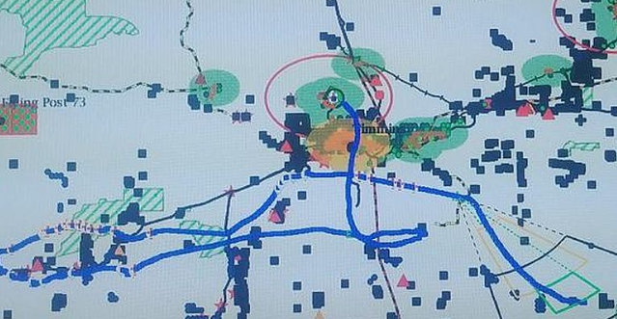
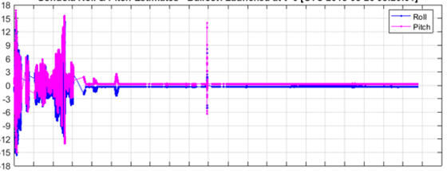
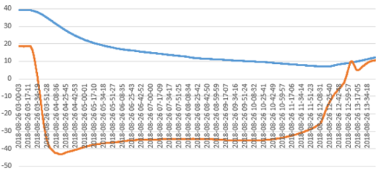
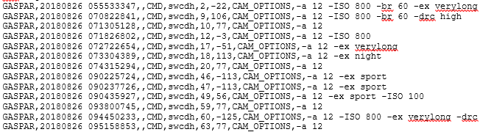
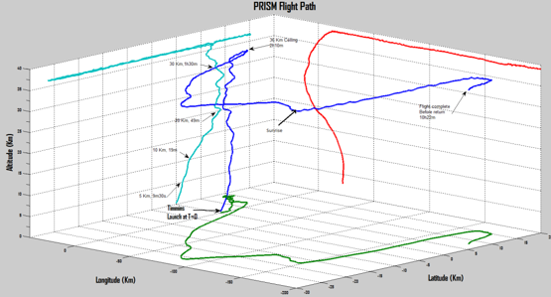
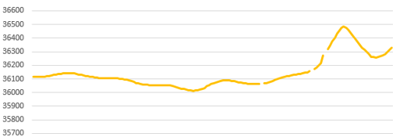
So now, what do we do with all of this ???

Slide 16
We need YOU to propose a new way to display our DATA so that users can intuitively understand them, LIVE and from ONE SCREEN…
What TIME is it?
What is the current
barometric PRESSURE?
How COLD or HOT?
How HIGH are we?
Where is the SUN?
WHERE are we?
Etc….

Slide 17


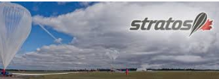


… and for various types of users:
Scientists, general public, kids
Note: Images from shutterstock royalty free

Slide 18
Conclusion
We hope to setup a public web site to follow future stratospheric balloon flights
Will YOUR design/solution be part of it?
Our evaluation will take into consideration look, imagination, but also technically feasibility (i.e. applicability to a web site).
Thank you for considering this challenge…
now let’s have fun ☺

