Slide 1
Explore Concentrations of Important Atmospheric Gases with SCISAT
CSA Space Apps Challenge 2019
S. Gray, MCC, BSc.
Dr. M. Dejmek, PhD, PEng.

Slide 2
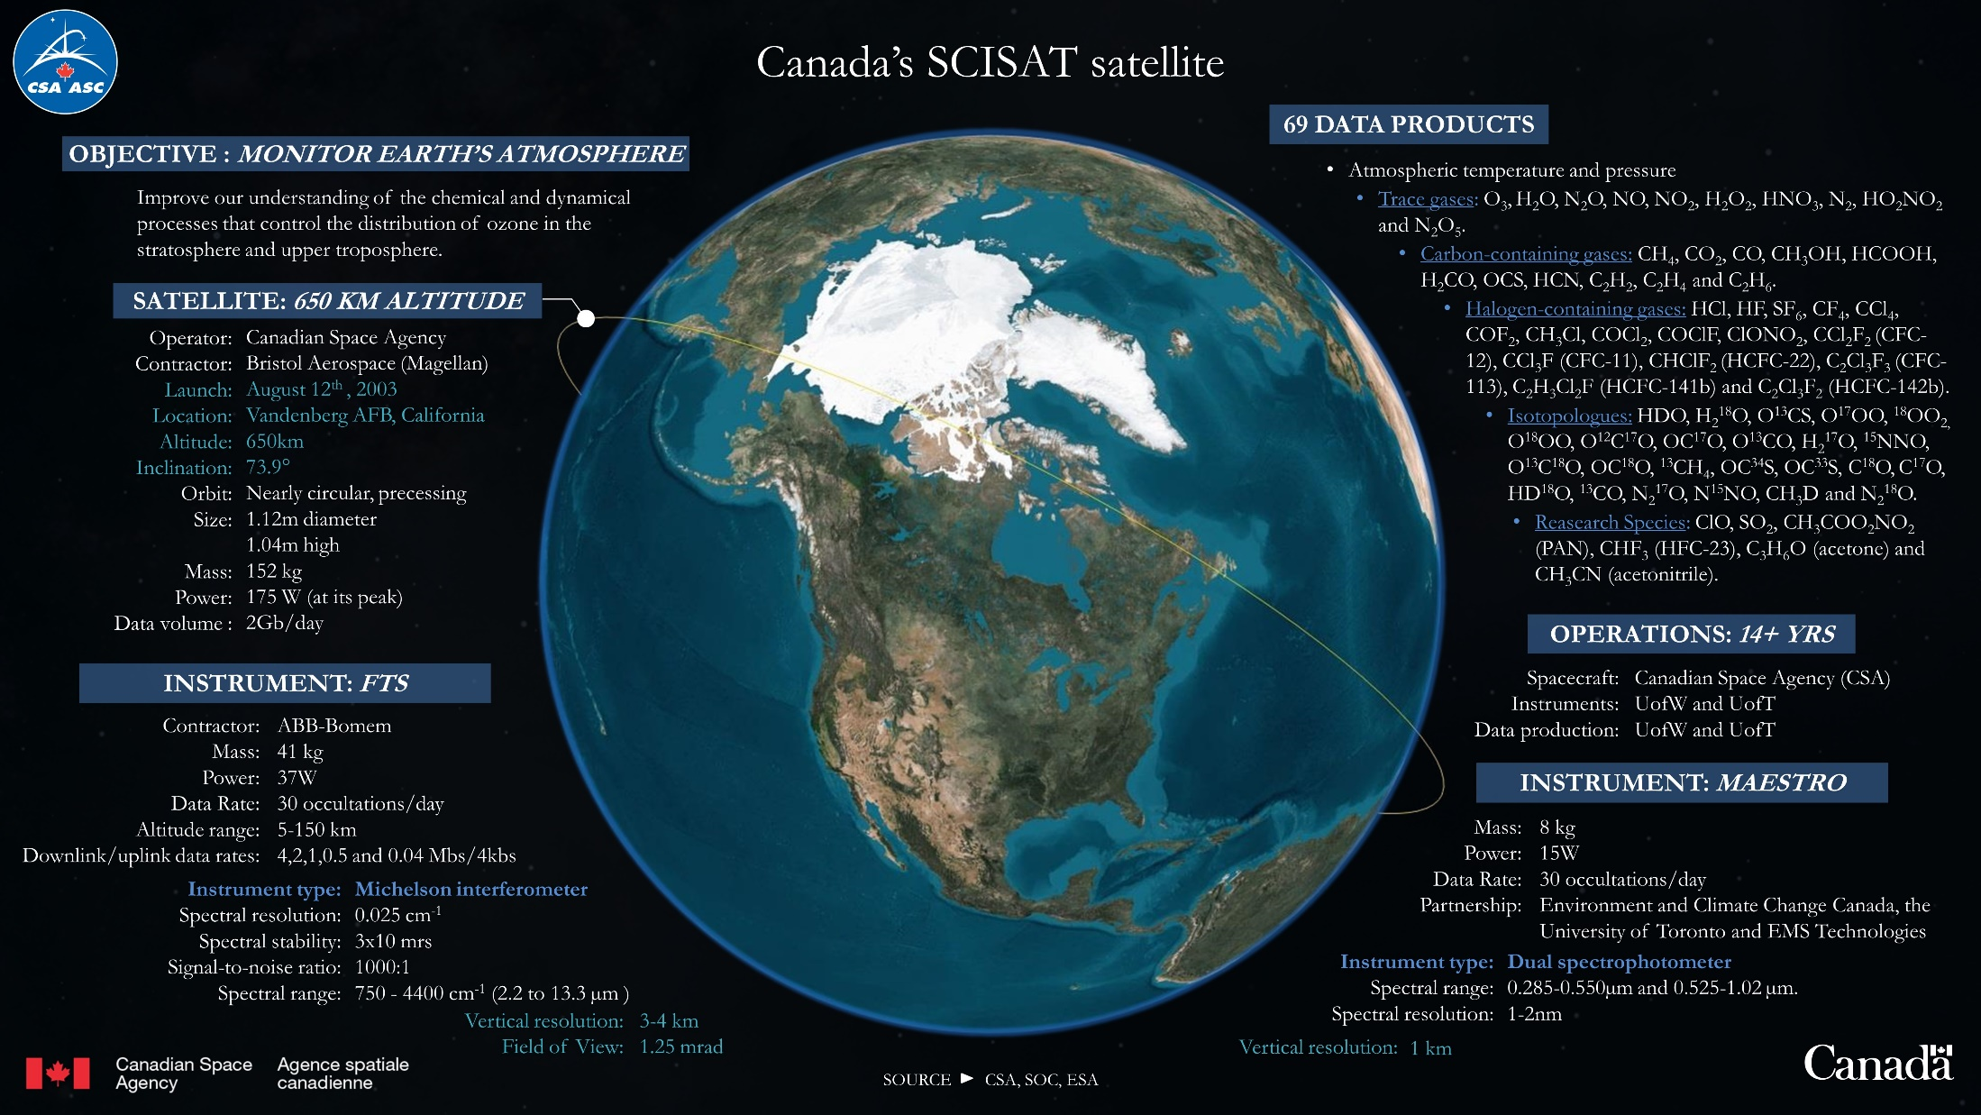

Slide 3
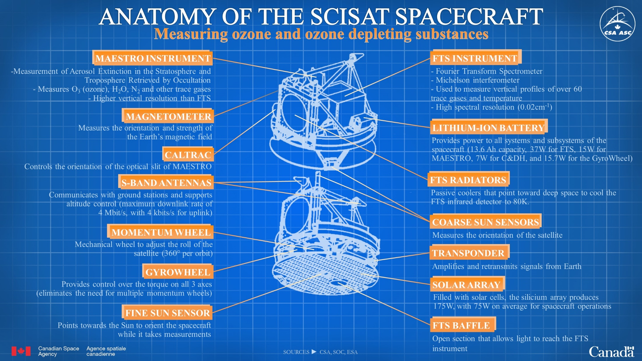

Slide 5
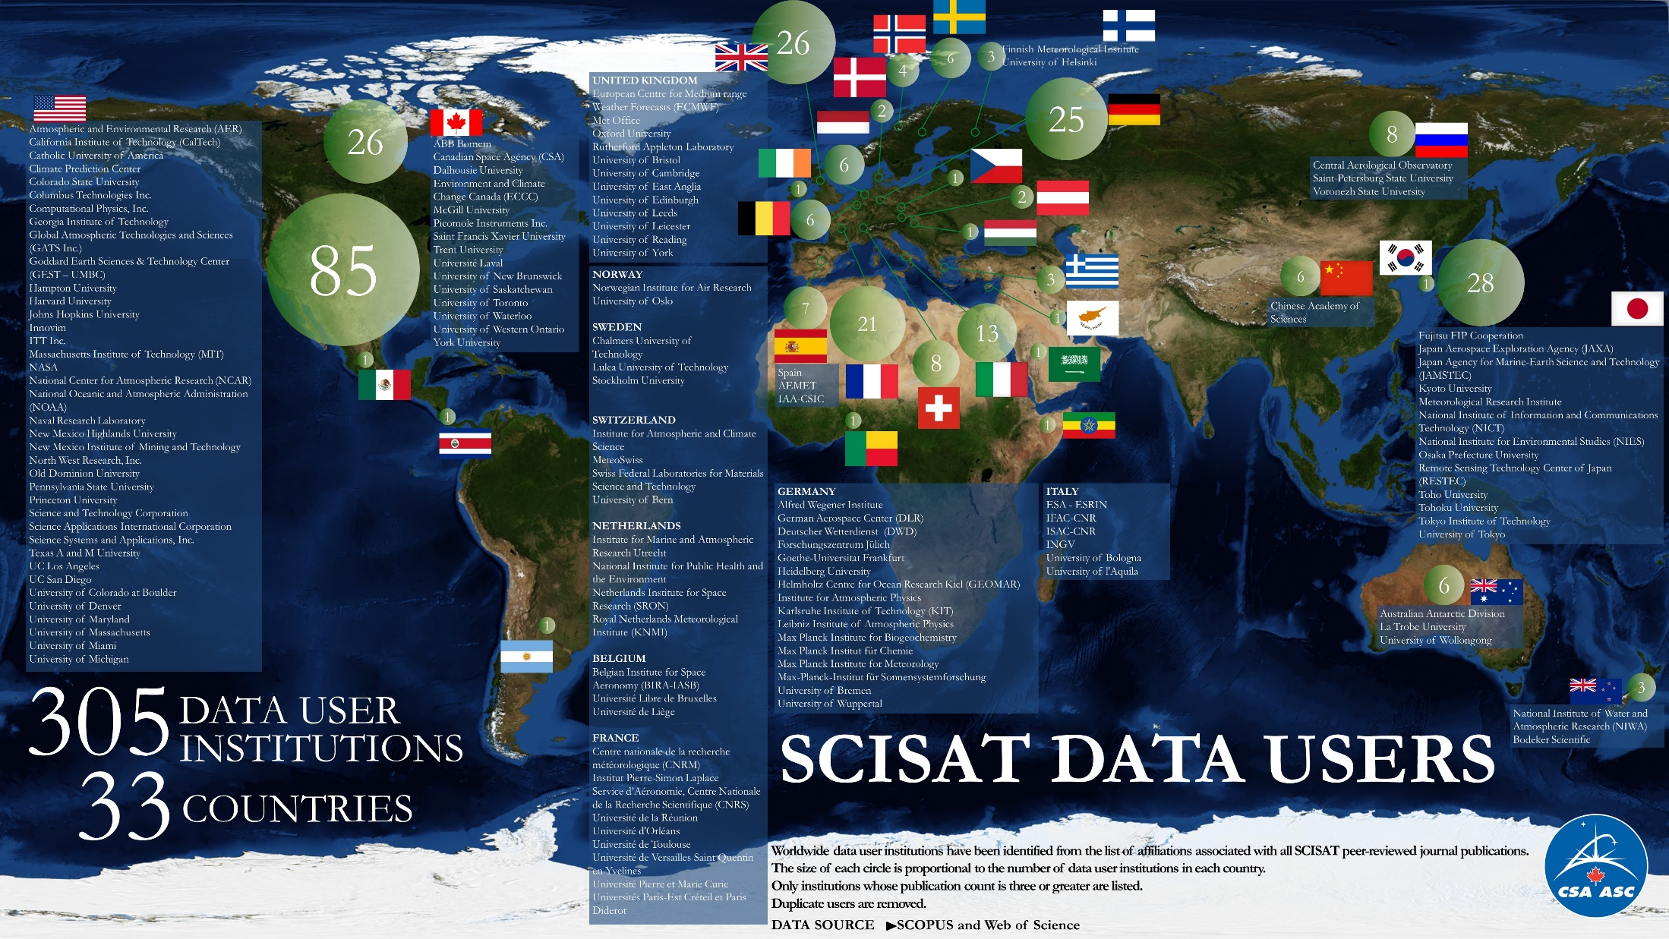

Slide 14
Reading the NetCDF files
Software needed: R and RStudio
Script #1: “all function”
Script #2: “netcdf import”
The above scripts will import the netcdf files and convert them to excel (CSV)
These scripts can be seen on the following slides

Slide 15
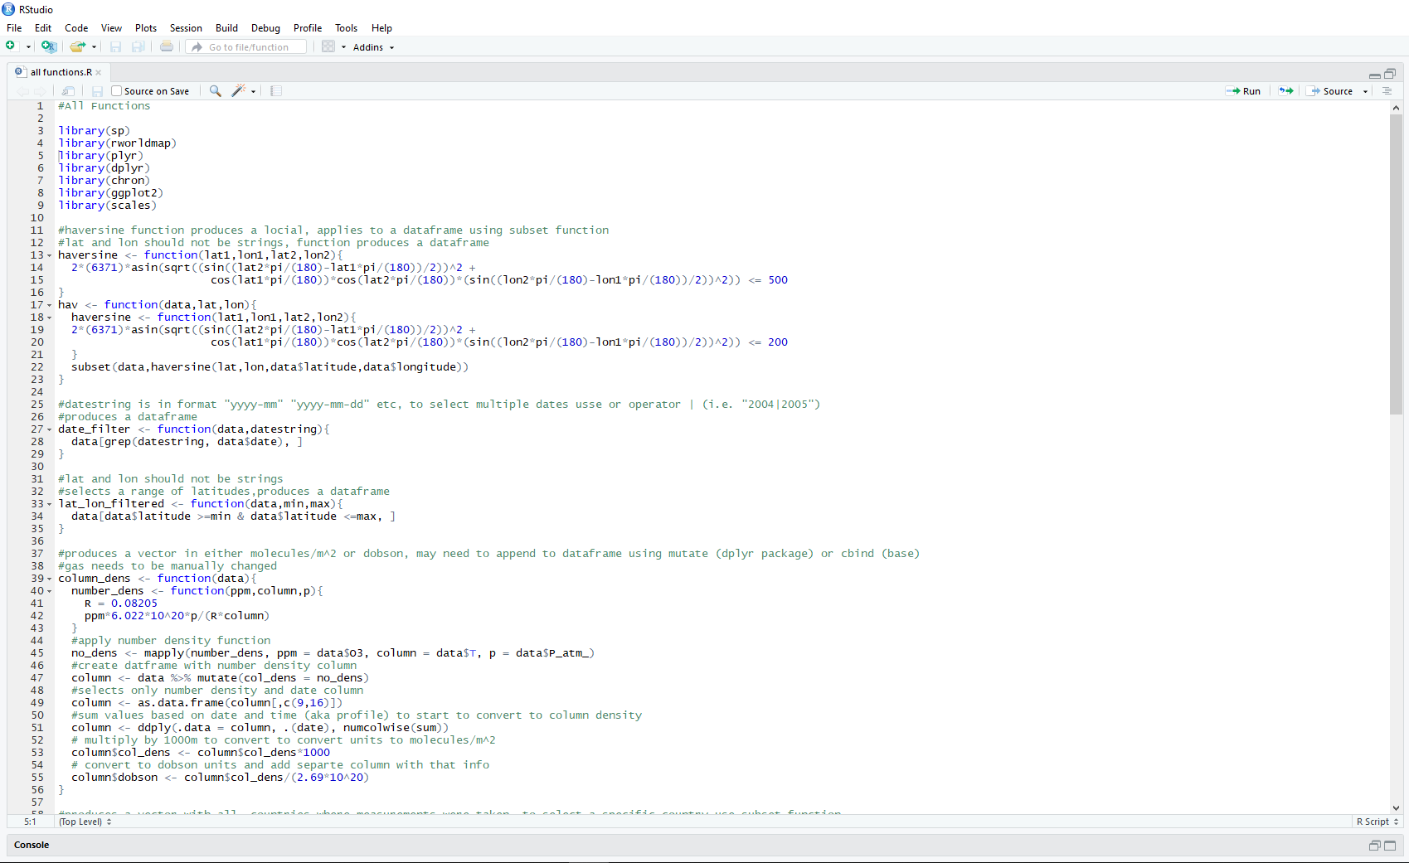
*** 1 877-413-4792 #1975079

Slide 16
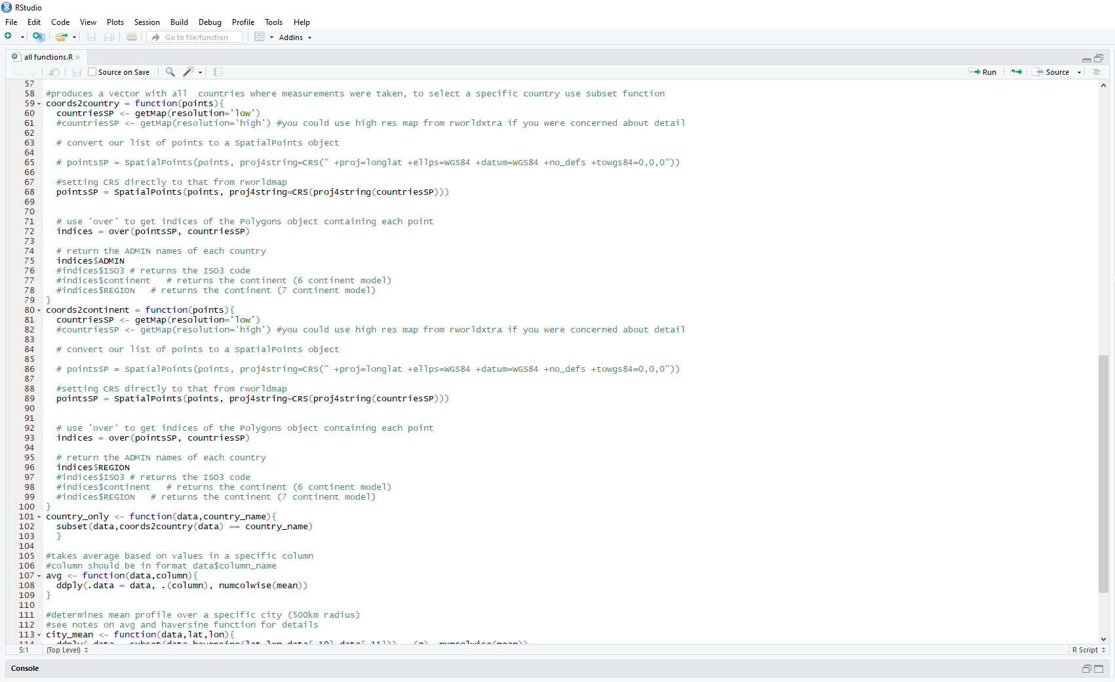

Slide 17
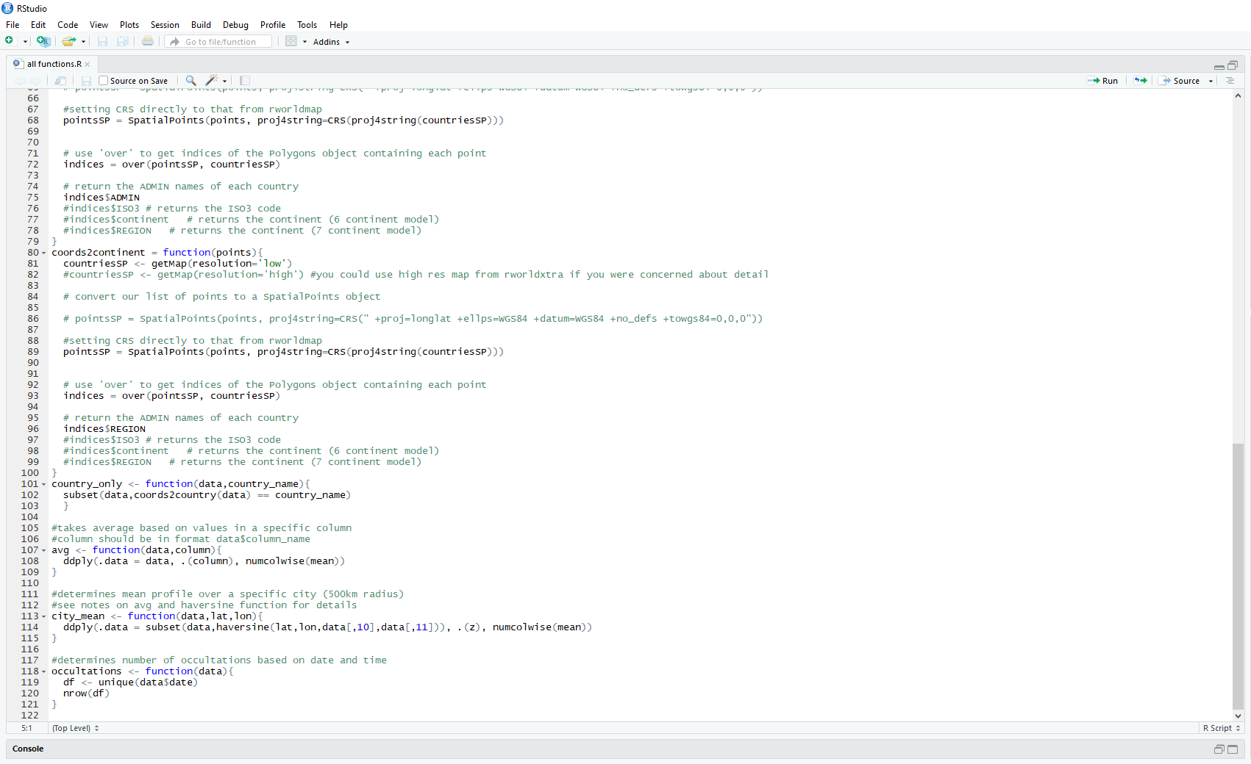

Slide 18
