Slide 1
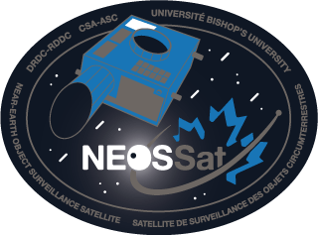
Space Apps Challenge - NEOSSat
CSA/V. Abbasi
CSA/N. Cziranka-Crooks
DRDC/S. Thorsteinson
DRDC/L. Scott
Bishop’s/J. Rowe
NRC/D. Balam

Slide 2
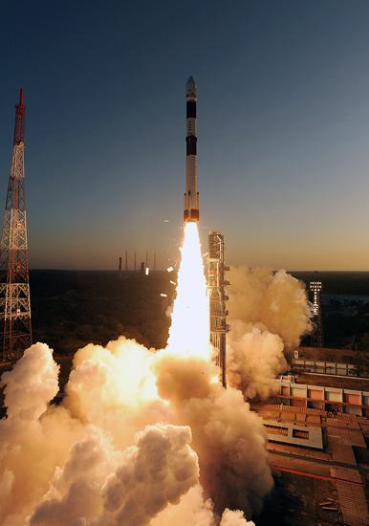
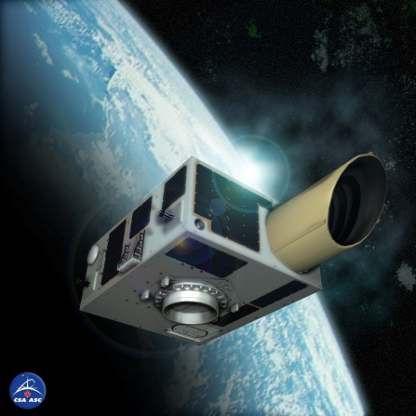
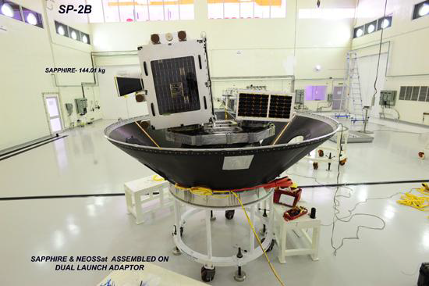
NEOSSat’s Hero’s Journey – Humble Beginnings
Launched in February of 2013
Microsatellite with a mass of ~74kg, based on MOST space telescope
On-board 15cm telescope & CCD to capture images
Custom boresight-aligned star tracker enables high precision Fine Pointing
Two primary objectives in a joint mission between DRDC and CSA
High Earth Orbit Space Surveillance (satellites, space debris…)
Near Earth Space Surveillance (asteroids, comets, …)
Launched 25 February 2013
PSLV C-20

Slide 3
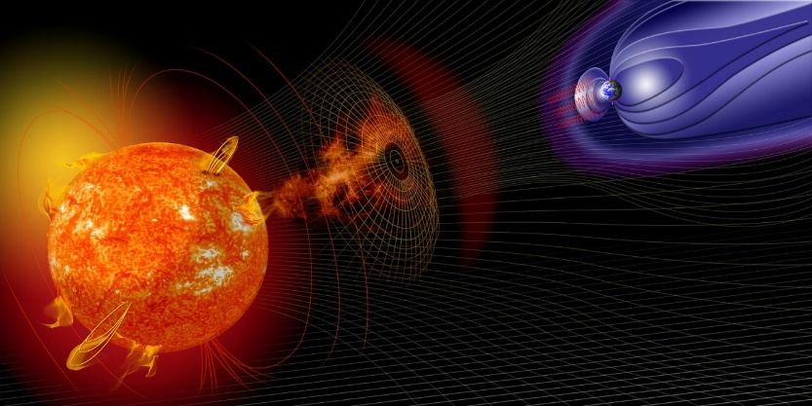
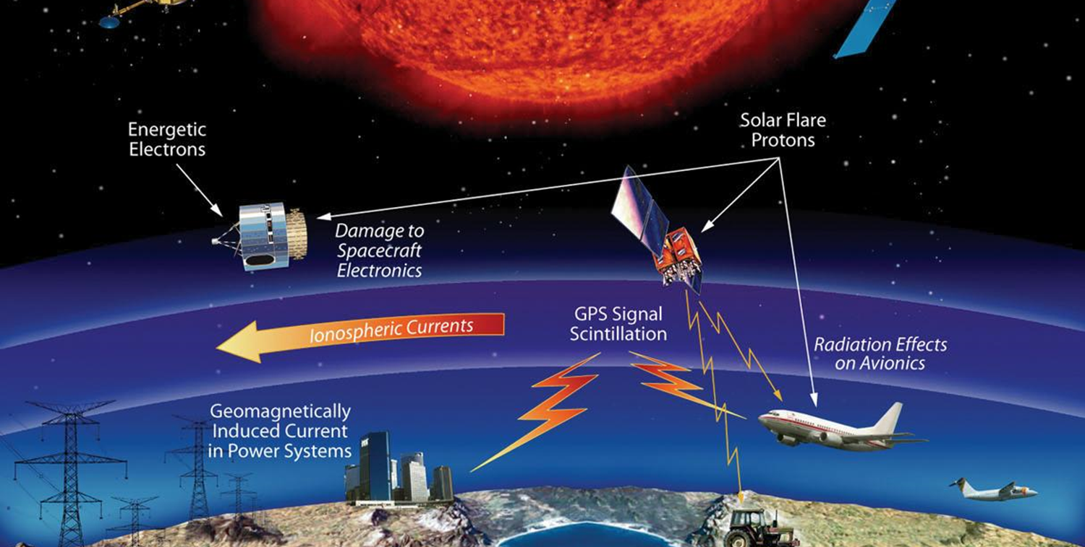
NEOSSat’s Hero’s Journey – Catastrophe Strikes
Two critical failures to crucial attitude control components
Magnetometer failure
A loss of a core coarse sensor prevents the satellite from getting an accurate enough lock to transition to fine pointing
Torque rod failure
Failure of the torque rods prevents the spacecraft from desaturating the momentum wheels which prevents spacecraft control/pointing

Slide 4
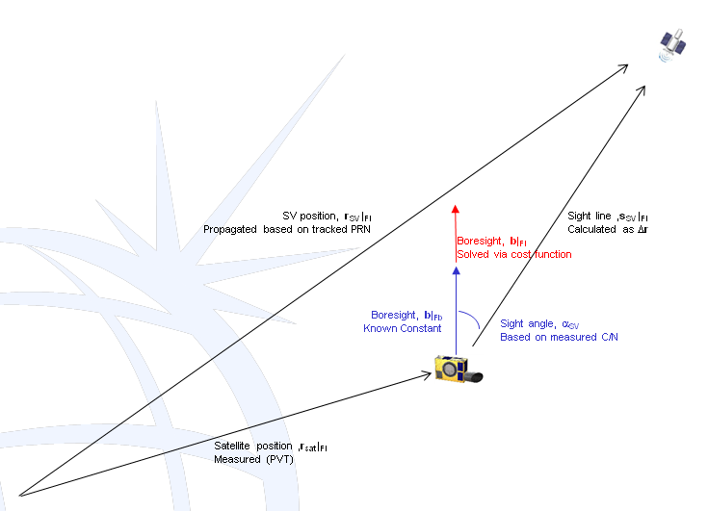
NEOSSat’s Hero’s Journey – Overcoming Adversity
Two novel solutions
GPS attitude sensor
Based on the signal pattern received from GPS satellites and knowing in which direction NEOSSat’s GPS antennas are pointed the satellite can determine its own orientation
Utilizing the satellites own magnetic dipole
This dipole can interact with the Earth’s magnetic field. This allows the entire satellite to act as a torque rod.
These innovative solutions brought NEOSSat back to operations

Slide 5
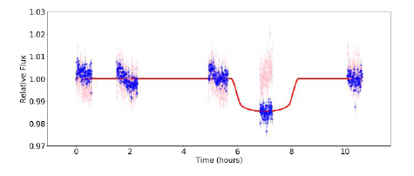
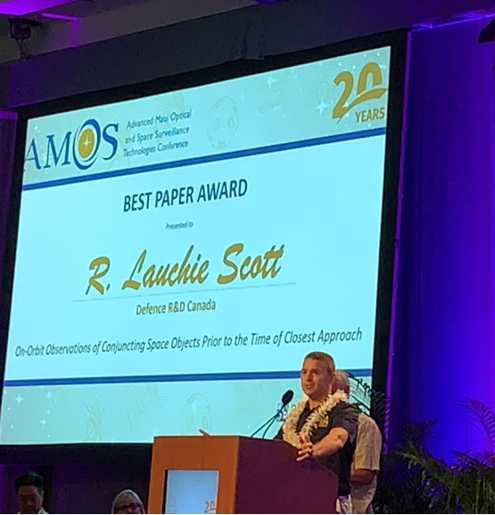
NEOSSat’s Hero’s Journey – Reaching New Heights
In returning to action NEOSSat has started to do science not originally planned
Capturing the transitions of exoplanets
Observing satellite conjunctions (when two satellites come into close proximity to one another) in LEO
Observing conjunctions occurring with NEOSSat itself
Non-differential photometry of WASP-33; exoplanet transit detected by dip in flux

Slide 6
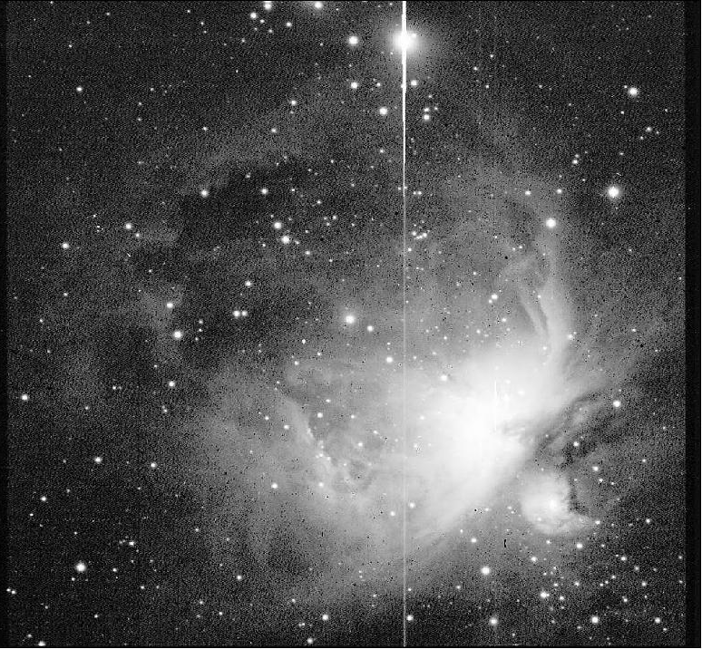
NEOSSat Images: FITS Format
NEOSSat image of the Orion Nebula
NEOSSat captures various images of different objects with different exposure lengths or frame sizes
All these images are stored in the Flexible Image Transport System (FITS) format, a standard format used in astronomy
First standardized in 1981
Image metadata is stored in a readable ASCII header
Many software packages available for data treatment
Python code for advanced image cleaning (overscan bias correction, dark correction) is available on Jason Rowe’s NEOSSat code library
(includes Jupyter Notebook examples)

Slide 7
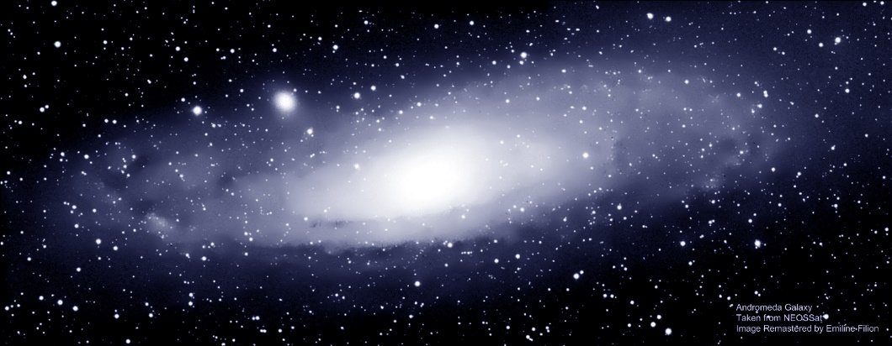
NEOSSat’s Images on Open Data
All NEOSSat astronomy images are sent to Open Data FTP after downlink
First level folder: Year (2018, 2019, …)
Second level folder: Day of Year (1 … 365)
Image Filenames:
Raw Images: NEOS_SCI_YYYYDDDHHMMSS.fits
Java overscan cleaning: NEOS_SCI_YYYYDDDHHMMSS_clean.fits
Python overscan cleaning: NEOS_SCI_YYYYDDDHHMMSS_cor.fits
Python overscan+dark cleaning: NEOS_SCI_YYYYDDDHHMMSS_cord.fits
ftp://ftp.asc-csa.gc.ca/users/OpenData_DonneesOuvertes/pub/NEOSSAT/ASTRO
YYYYDDDHHMMSS: Year, Day of Year, Hour, Minute, Second of start of exposure
Image cleaning removes different instrument artifacts of the original image, allowing deeper study characteristics of interest

Slide 8
Using FITS files
To simply view a FITS image an image processing program such as ImageJ, GIMP, IrfanView, etc. should be sufficient
The FITS Liberator is a dedicated software program for FITS images used by scientists at ESA and NASA
To do more extensive analysis or work you will likely want to switch to code
Plenty of programming languages have libraries designed to interact with FITS files
FITS I/O Libraries
Notes:
Is Gimp & IrfanView ok?

Slide 9
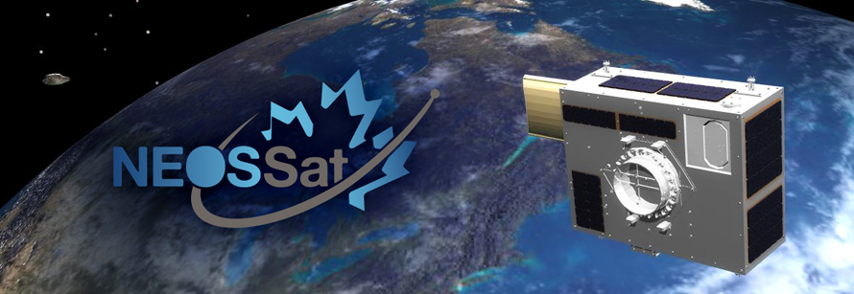
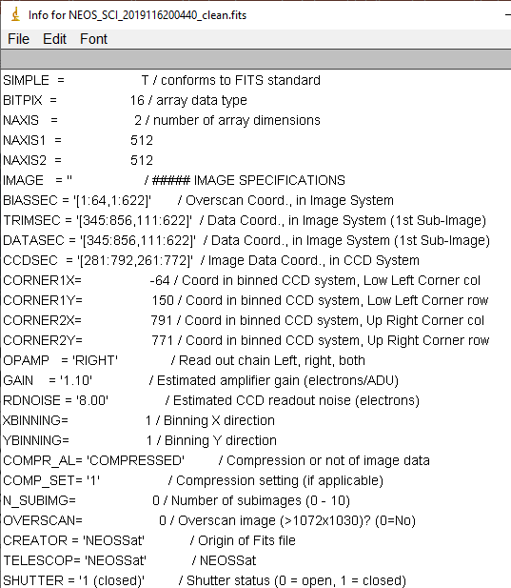
FITS Headers
Each FITS image has an important header section with information about the image, such as:
Spacecraft mode (Fine Point…)
Pointing of the spacecraft
Position of the spacecraft
Observation time, exposure duration, …
Raster size, Binning
Temperatures (CCD, …)
…
All FITS software can query headers
NEOSSat header descriptions in FITS Image User Guide @
ftp://ftp.asc-csa.gc.ca/users/OpenData_DonneesOuvertes /pub/NEOSSAT/SupportingDocuments/

Slide 10
NEOSSat Space Apps Challenges
 | (1) Image Search Tool | (2) Analyze the Images | (3) Animate an Asteroid/Comet
Objective | Building a flexible database for finding the data meeting user-defined criteria | Analyze differences between images of the same region of space to identify moving objects or other changes | Build animations from a series of images of a moving asteroid or comet
Skill Set | Database design | Data mining, Artificial Intelligence | Visualization
Data Set | Any image set, extracting & storing header data | Cleaned images in “Fine Point” state from survey images (same region over different orbits) | Cleaned images from of a given target over many days

Slide 11
Challenge #1 – Searching the Image Database
Use FITS image headers to build a searchable data structure and simplify access to all images meeting specific criteria
Example: use your tool to find all images taken of “TargetY” or all images pointing in a specific section of the night sky (RA/Dec range)
Feel free to take a look at the astropy section on working with FITS Headers to get a general understanding of interacting with headers

Slide 12
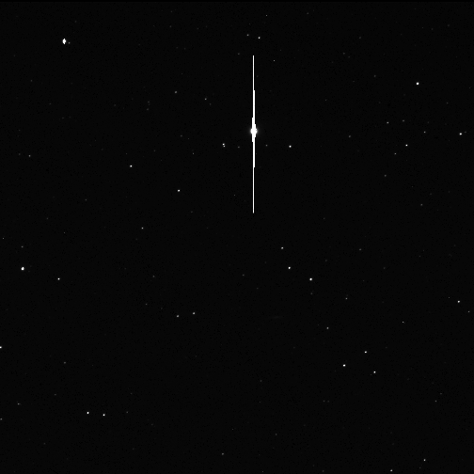
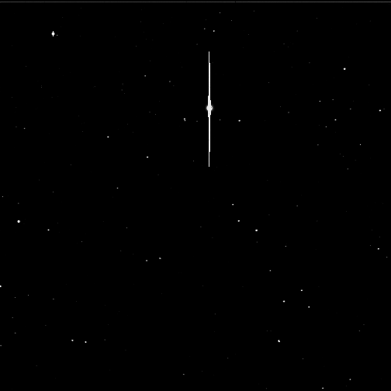
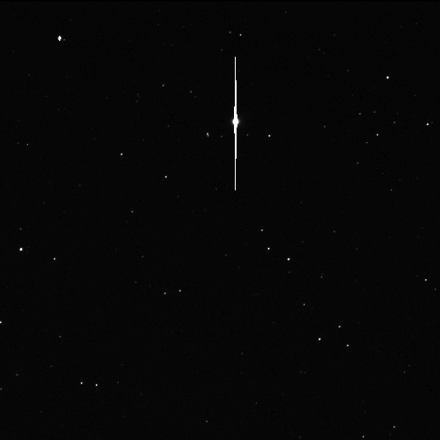
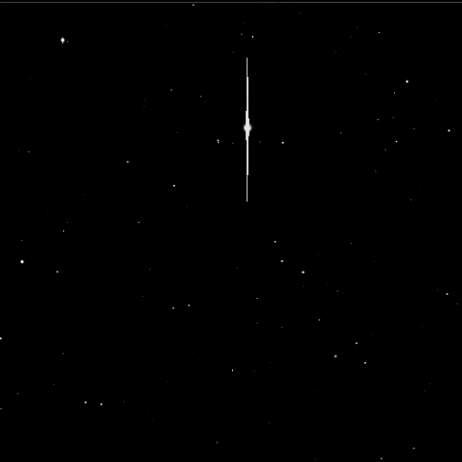
Challenge #2 – Identifying potential asteroids or other dynamic objects
Detecting in space can be a difficult task
Image change detection is an important field of study that has been used for a long time in astronomy
Looking at multiple images of the same object or point in space can allow comparison between the images to detect a moving object such as an asteroid or comet
100s Fine Point Exposure @ RA/Dec/Roll = [6.31, -2.30, 161.7] deg
2017-138 14:07:17
2017-138 14:35:42
2017-138 14:47:45
2017-138 16:16:10

Slide 13
Challenge #3 – Animating a Comet or Near-Earth Asteroid
Your challenge is to use asteroid or comet images to create interesting visualizations or animations
Comet 46P animations
Notes:
Astronomers and researchers are seeking different things from images than most
They are not always concerned with the appealability or attractiveness of the photos as this doesn’t necessarily contribute to the science
Others however appreciate something that is clear and understandable at a glance

Slide 14
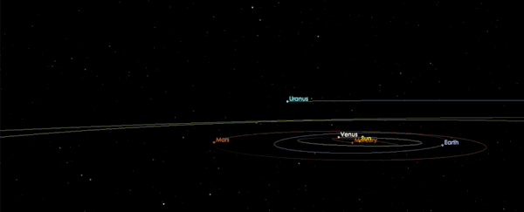
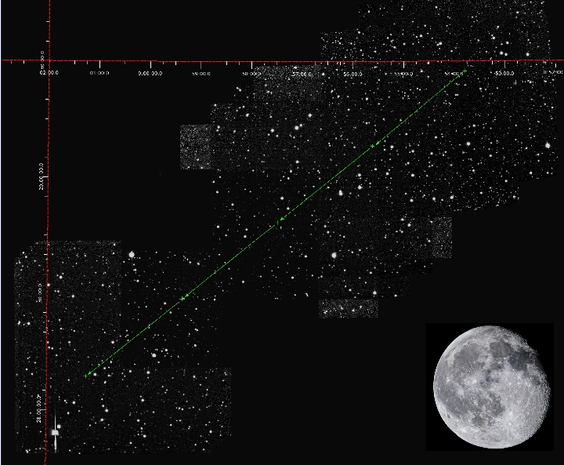
1st Interstellar Comet C/2019 Q4 (2I/Borisov)
Daily imaging: 2019-256 to now
NRC/D. Balam processing data with measurements published on MPC
Mosaic of 91 NEOSSat images re-sampled to a tangential projection in FK5/J2000 coordinates showing the trajectory of 2i/Borisov from UT Sept. 13 (upper right) to Sept. 17 (lower left). The full moon is shown to scale for comparison
Each raw image is 100s exposure in Fine Point; Image stacking reveals the comet

