Slide 1


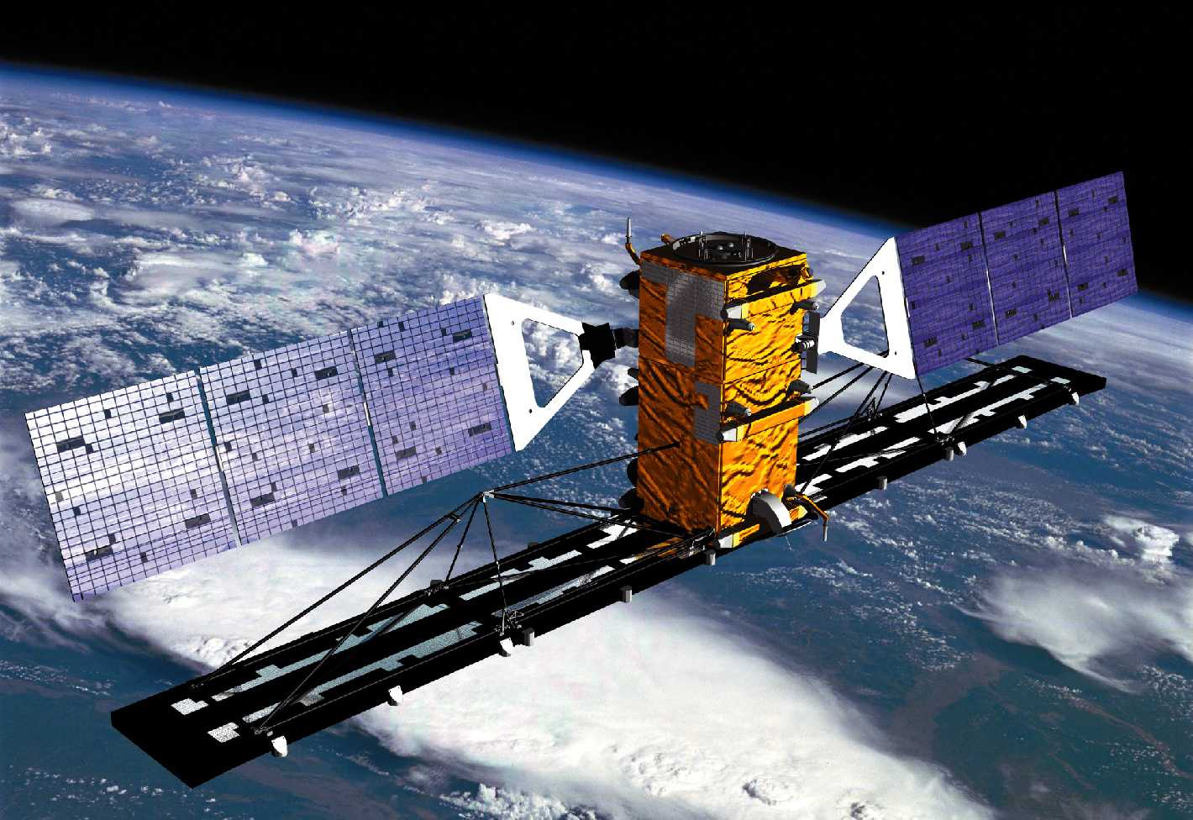
Canada Mosaic (May 2013)
Daniel De Lisle
SatOps, Infrastructure & Applications
Canadian Space Agency
© Government of Canada (2016)

Slide 2
Objectives
To update the R1 Mosaic done in 1997
Simultaneous R1 acquisition planned for complementary polarization
  (HH R1 + VV/VH R2)
  However R1 ceased operations on March 2013
Provide standard coverage in preparation for RCM to GoC Users
Provide provincial clippings to stimulate use by Provinces (R2 and upcoming RCM)
Provide Printable products for General Public
  Giant map by the The Royal Canadian Geographical Society (11m x 8 m ) for high school teaching
Basemap product to be used for upcoming conferences (IGARSS, IAC) and Publications
Provide Google Earth compatible format (.kml) at 100m for FGP (NEW)

Slide 3
Data processing
Mosaic Production
Acquisition Details
- Beam Modes - RADARSAT-2 ScanSAR Wide A
- Period of Acquisition – May 1, 2013 – June 1, 2013
- Number of products – 121 products
- LUT: Constant Beta
- Bit depth: 16-bit
- Base elevation (mean terrain height correction) applied in processing was “0”
- path-image SGF processing level
- a basic QA check for coverage and artefacts was performed on each processed image as they were output from the MDA-GSI processor

Slide 4
Product Ortho-rectification (PCI Geomatica 2013)
- data imported as calibrated value sigma-nought (32 bit)
- data converted to dB using the base 10 logarithm function [10*(log(calibrated value)]
- ortho-rectification applied using the 50K CDED DEM tiles accessed from GeoBase at http://www.geobase.ca/geobase/en/data/cded/
- Projection parameters:
        PROJECTION_NAME: Lambert Conformal Conic
        DATUM_NAME: WGS 84
        TrueOriginLongitude 100d00'00.000"W
        TrueOriginLatitude 40d00'00.000"N
        1stStandardParallel 49d00'00.000"N
        2ndStandardParallel 77d00'00.000"N
        FalseEasting 0.0
        FalseNorthing 0.0
- secondary QA checks were then performed on all resulting Orthorectified files to check for any registration issues, general colour balancing in anticipation of the mosaic stages, and to ensure that the coverage were without gaps

Slide 5
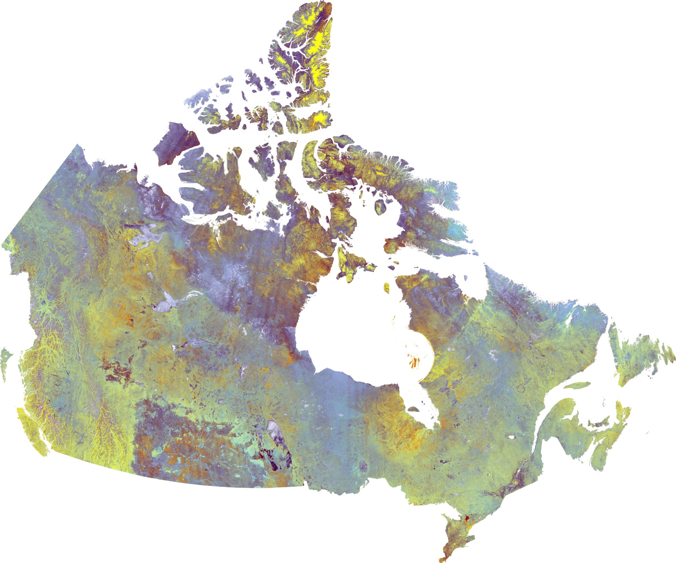
R2 Canada Mosaic (May 2013)
RADARSAT-2 Data and Products © MacDONALD, DETTWILER AND ASSOCIATES LTD. (2013)
All Rights Reserved” and “RADARSAT is an official mark of the Canadian Space Agency

Slide 6
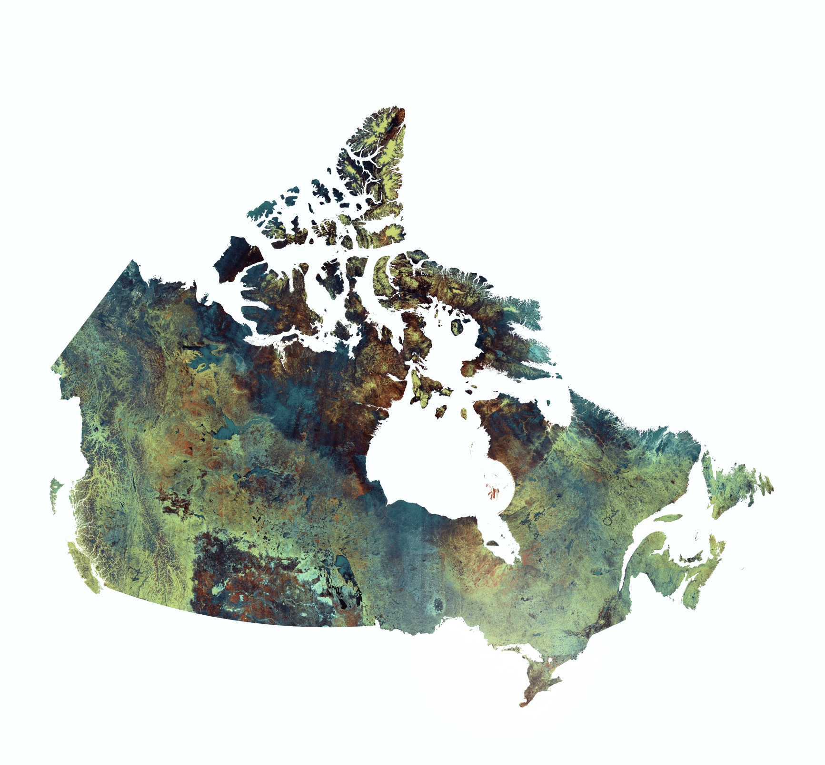
R2 Canada Mosaic (May 2013)
RADARSAT-2 Data and Products © MacDONALD, DETTWILER AND ASSOCIATES LTD. (2013)
All Rights Reserved” and “RADARSAT is an official mark of the Canadian Space Agency

Slide 7
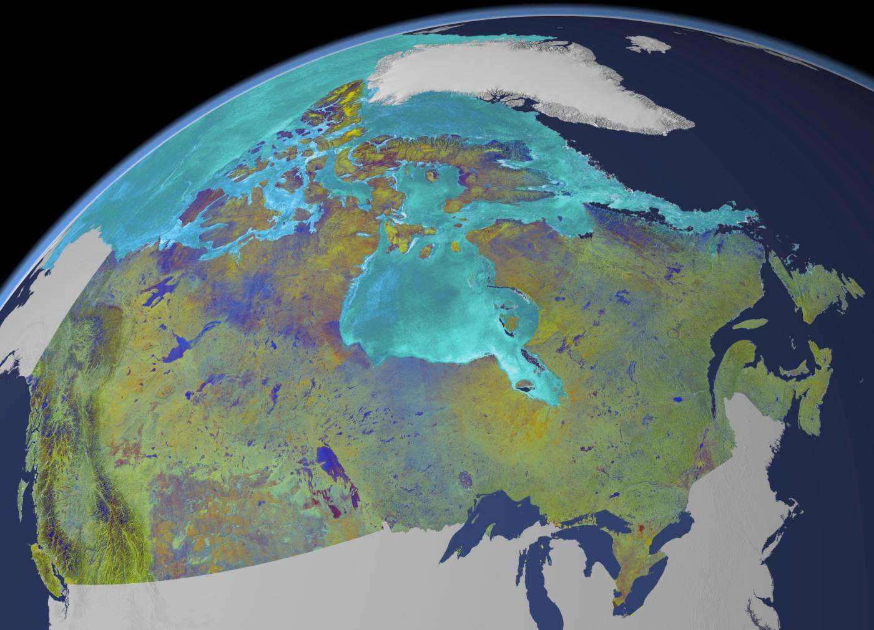
RADARSAT-2 Data and Products © MacDONALD, DETTWILER AND ASSOCIATES LTD. (2013)
All Rights Reserved” and “RADARSAT is an official mark of the Canadian Space Agency

Slide 8
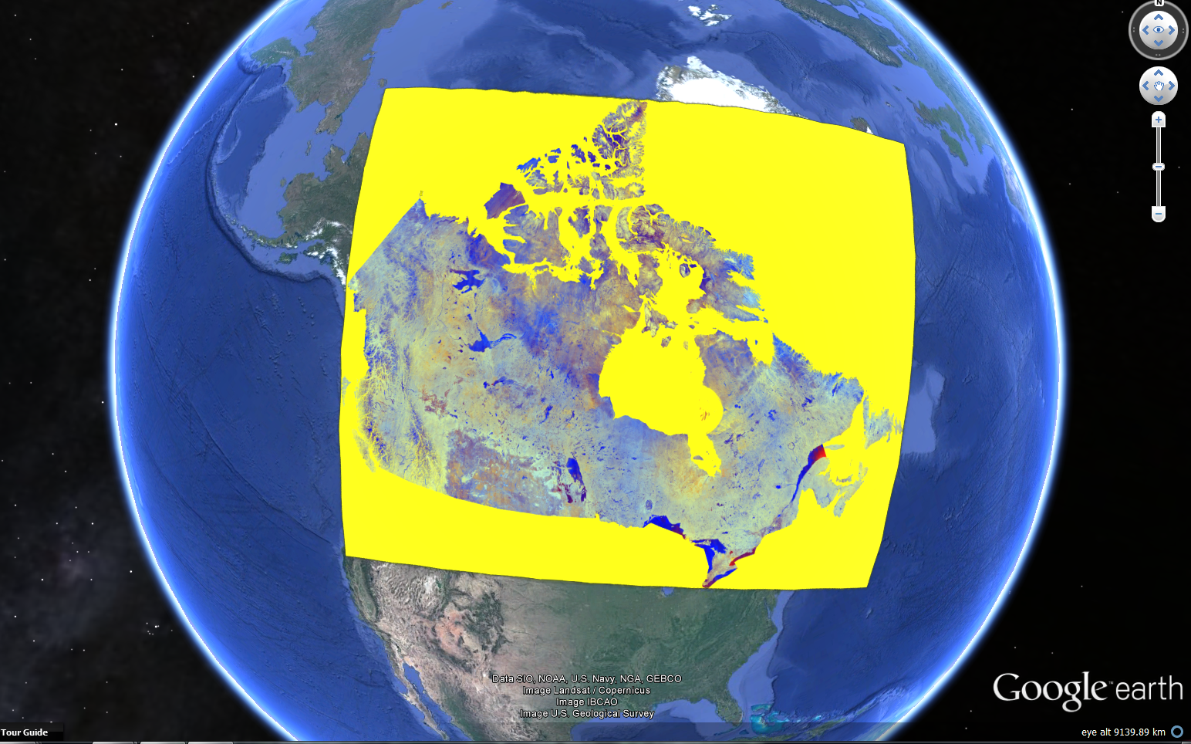
Google Earth (.kml) at 100m resolution
RADARSAT-2 Data and Products © MacDONALD, DETTWILER AND ASSOCIATES LTD. (2013)
All Rights Reserved” and “RADARSAT is an official mark of the Canadian Space Agency

Slide 9
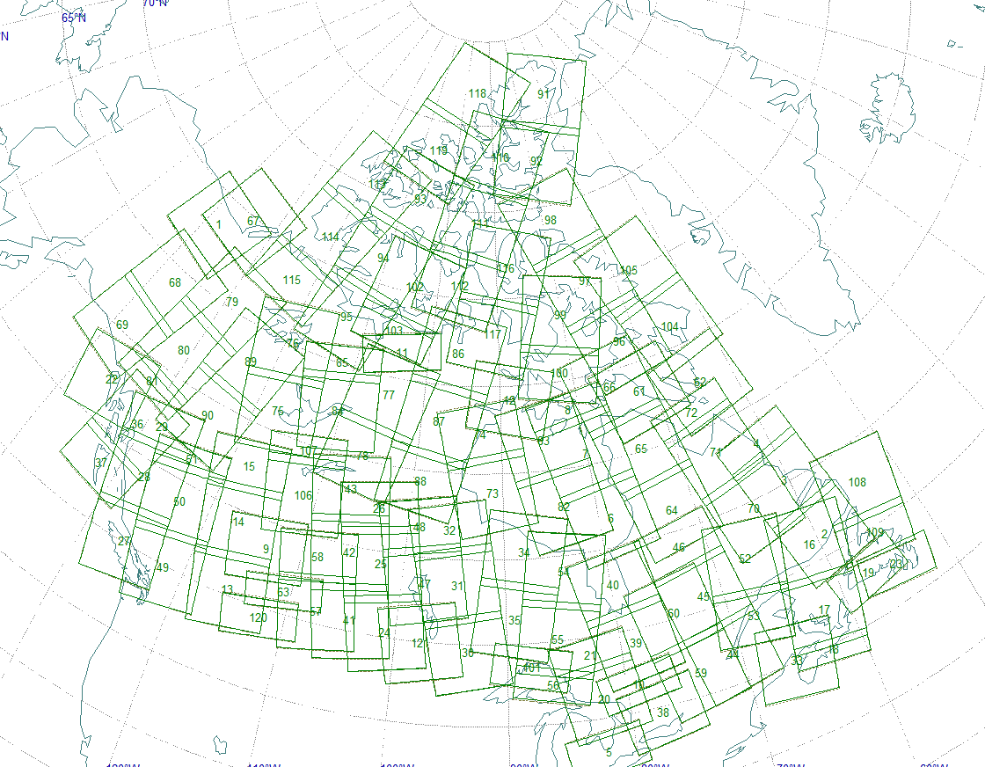
Images RADARSAT-2 utilisées pour la Mosaique du Canada

Slide 10
121 images acquises / 60 orbites
Start time | Pass | Frames
2013-May-02 21:45:07.923 | ASC | 3
2013-May-02 23:23:45.480 | ASC | 1
2013-May-03 22:58:03.077 | ASC | 3
2013-May-06 01:19:58.173 | ASC | 1
2013-May-06 23:08:06.140 | ASC | 1
2013-May-08 00:25:09.493 | ASC | 1
2013-May-09 01:31:34.967 | ASC | 3
2013-May-09 21:40:14.680 | ASC | 1
2013-May-09 23:20:14.636 | ASC | 2
2013-May-10 02:45:00.420 | ASC | 1
2013-May-11 00:32:47.793 | ASC | 3
2013-May-11 02:13:29.843 | ASC | 3
2013-May-12 00:03:10.673 | ASC | 3
2013-May-13 23:03:07.947 | ASC | 1
2013-May-13 23:04:18.787 | ASC | 2
2013-May-14 00:45:29.167 | ASC | 3
2013-May-14 22:34:15.670 | ASC | 3
2013-May-15 00:16:53.703 | ASC | 2
2013-May-15 01:56:38.963 | ASC | 3
2013-May-17 00:58:05.863 | ASC | 2
2013-May-17 22:46:44.000 | ASC | 2
2013-May-18 22:22:11.447 | ASC | 1
2013-May-19 21:52:34.143 | ASC | 1
2013-May-20 01:11:13.280 | ASC | 1
2013-May-21 22:32:43.487 | ASC | 3
2013-May-22 22:02:51.470 | ASC | 3
2013-May-22 23:44:51.757 | ASC | 2
2013-May-23 01:26:16.013 | ASC | 2
2013-May-23 23:15:10.307 | ASC | 2
2013-May-24 00:57:13.657 | ASC | 2
2013-May-25 22:18:51.037 | ASC | 3
2013-May-26 21:49:24.003 | ASC | 2
2013-May-27 01:08:18.650 | ASC | 2
2013-May-30 01:19:01.407 | ASC | 1
2013-Jun-01 00:20:05.183 | ASC | 1
Start time | Pass | Frames
2013-May-01 15:48:31.745 | DES | 1
2013-May-08 12:24:04.050 | DES | 1
2013-May-09 10:17:35.450 | DES | 3
2013-May-10 09:49:35.447 | DES | 1
2013-May-12 10:31:54.300 | DES | 1
2013-May-12 12:09:43.473 | DES | 2
2013-May-13 15:01:34.723 | DES | 2
2013-May-15 10:42:31.230 | DES | 2
2013-May-16 11:53:18.417 | DES | 3
2013-May-22 15:35:30.980 | DES | 1
2013-May-22 15:37:07.480 | DES | 2
2013-May-23 13:27:01.927 | DES | 2
2013-May-23 15:07:23.070 | DES | 3
2013-May-24 12:56:49.630 | DES | 3
2013-May-24 14:38:41.123 | DES | 2
2013-May-25 12:23:09.064 | DES | 2
2013-May-25 14:05:43.230 | DES | 3
2013-May-26 11:57:30.297 | DES | 2
2013-May-26 12:03:33.360 | DES | 1
2013-May-26 13:37:47.963 | DES | 2
2013-May-27 09:51:54.907 | DES | 2
2013-May-27 13:06:06.007 | DES | 3
2013-May-27 14:47:42.287 | DES | 3
2013-May-28 12:38:36.510 | DES | 2
2013-May-28 14:16:18.490 | DES | 2

Slide 11

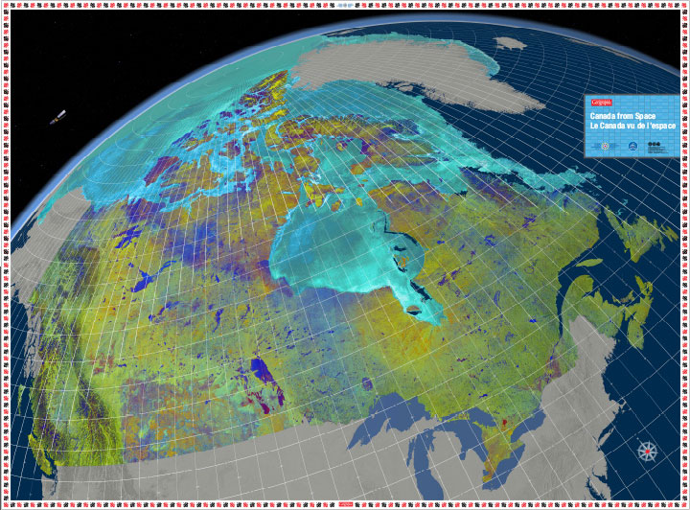



Giant floor maps
Canada from Space
Availability:
The Giant Floor maps are available on loan for 3-week periods throughout the school year and by special request during the summer.
Floor map dimensions:
Dimensions 10.7 m (35') x 7.9 m (26')
Diameter of Shipping tube: 32 cm (13")
Trunk: 82 cm (32") x 46 cm (18") x 58 cm (22.5")
The activity trunk includes:
Teacher’s guide
Information on Canada’s energy landscape
Hard copies of all activities.
http://www.rcgs.org/programs/education/giant_floor_maps.asp

Slide 12
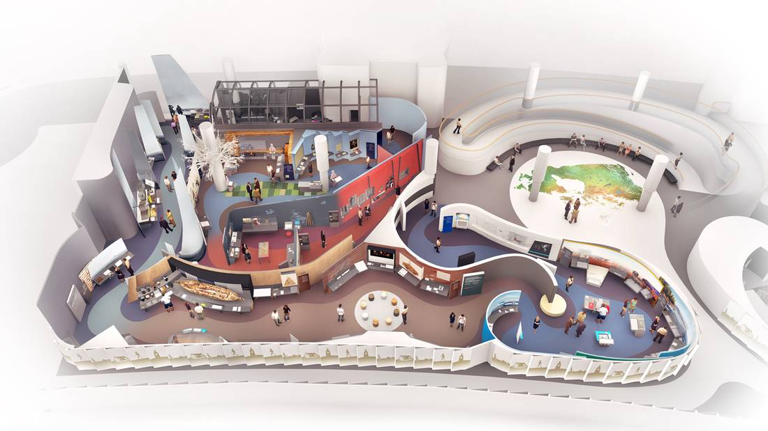
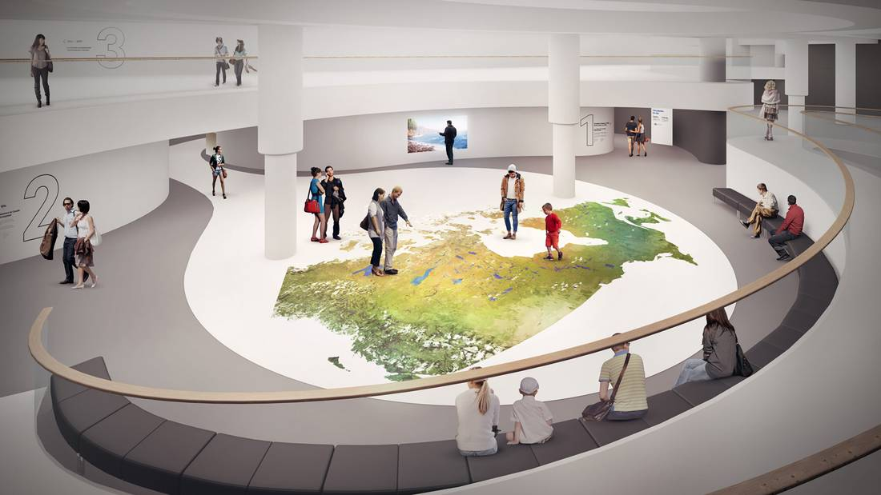

La Salle de l’histoire canadienne
La construction de la nouvelle Salle de l’histoire canadienne vient de prendre un autre bond en avant avec l'installation d'une image géante du Canada vu de l'espace.
Située à l'étage du Hub, au centre de la salle, la carte couvre 8 x 11 mètres (26 x 36 pieds). Elle est composée d'images prises par le satellite RADARSAT-2 de l'Agence spatiale canadienne, pour faire le plancher qui est vraiment hors de ce monde.

Slide 13
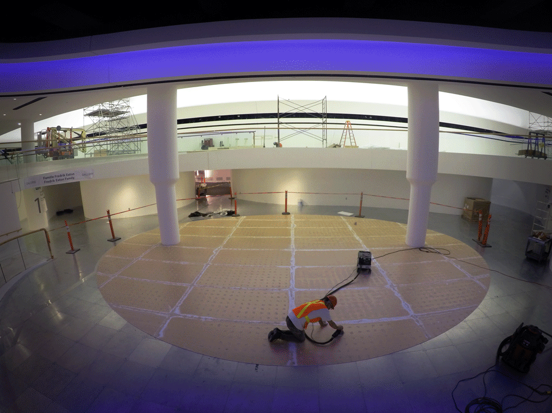

Slide 14
Contact information
Daniel De Lisle
SatOps, Infrastructure & Applications
Utilisation de l’espace | Space Utilisation
Agence spatiale canadienne | Canadian Space Agency
6767, route de l'Aéroport, Saint-Hubert (Québec) J3Y 8Y9
Tél/Tel : (450) 926-6611 | Téléc/Fax: (450) 926-4613
Courriel/E-mail : [daniel.delisle@asc-csa.gc.ca]

